Slide 1
Production and Cost

Slide 2

Wilson Football Factory

Slide 3
Total Revenue, Total Cost and Profit
Total Revenue is the amount a firm receives for the sale of its output which is nothing but TR = P × Q
Total Cost is the amount a firm pays to buy the inputs into production.
Profit is Total Revenue minus Total Cost. (Π=TR-TC)

Slide 4
Cost as opportunity cost
Total Cost = Explicit cost + Implicit cost
Explicit Cost for inputs that require an outlay of money by the firm.
An implicit cost is for inputs costs that do not require an outlay of money by the firm.
Accountants only consider explicit costs, which require an outlay of money by the firm.
Economists consider both explicit and implicit costs, which do not require an outlay of money by the firm.
Sacrificed income of an entrepreneur is an opportunity cost of their being in business.

Slide 5
The cost of capital as an opportunity cost
We have company with the asset value of 1 billion and it earns a annual profit of 10 million which is nothing but 1 % of 1 billion.
If 1 billion is just kept in the bank (min 2% interest rate) it would have earned 20 million as interest rate.
Profit = 10 million -20 million =-10 million

Slide 6
Accounting Profit Vs Economic Profit
Accounting Profit = Total Revenue –Explicit cost
Economic Profit = Total Revenue – (Explicit cost+ Implicit cost)

Slide 7
Types of Cost –Fixed and Variable Costs
Total Cost = Fixed Cost( FC) +Variable costs(VC)
Fixed costs are those that do not vary with output. It includes rents, insurance, depreciation, property tax, wages for skilled labourers.
Variable costs are costs that do vary with output, and they are also called direct costs. Examples of typical variable costs include fuel, raw materials, and some labour costs.

Slide 8
Production Function
Production Function – the relationship between quantity of inputs used to make a good and quantity of output of that good. Q = f (land, labour, capital)
Firm operates in the short run. Difference between short run and long run-in the short run one or more factors are fixed (factory space). In the long run all the factors of production are variable.
In the short run firm operates with fixed factor-factor which cannot be varied within a given period of time.
In the long run firm operates with variable factor-factors which can be varied within given period of time.

Slide 9
Short Run Vs Long Run
Short Run
Long Run
The Short run is the period of time that is long enough to adjust variable inputs such as raw materials and production labour but too short to allow all inputs to be changed. In short run fixed factors such as plant and equipment cannot be fully modified or adjusted.
In the long run all inputs can be adjusted including labour, materials and capital. Hence in the long run all costs are variable and none are fixed.

Slide 10
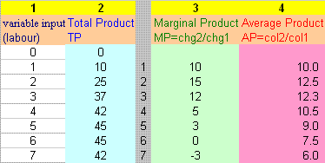

Slide 11
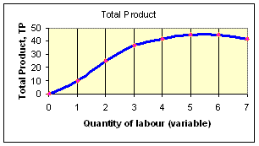
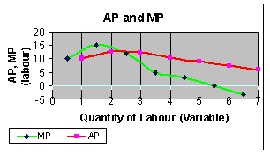

Slide 12
Law of Diminishing Marginal Product
The Law of diminishing marginal product states that as we increase one input and hold other inputs constant, the marginal product of the varying input will, at least after sometime, decline.

Slide 13
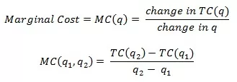
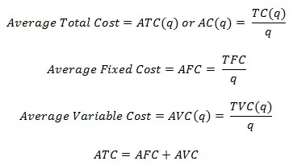
Average Total Costs, AVC,AFC and Marginal Costs

Slide 14
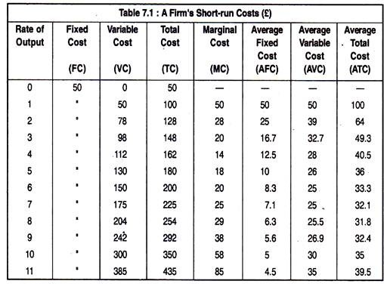
The various measures of costs

Slide 15
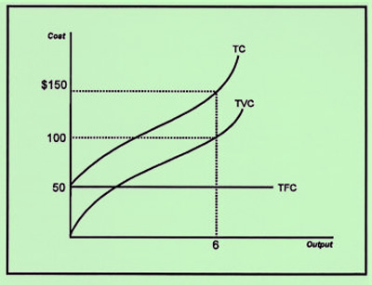
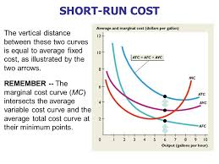

Slide 16
Points to remember in the shapes of costs curve
Whenever the MC is less than ATC, ATC is falling.
When MC is greater than ATC, ATC is increasing.
Marginal Cost eventually rises with the quantity of output
The ATC is U shaped
The Marginal Cost curve crosses or intersects the ATC curve at the minimum of ATC.
Output produced at the minimum of ATC is efficient scale output.

Slide 17
Returns to Scale
Effect of Increasing all the inputs
Constant Returns to scale
Denote a case where a change in all inputs leads to a proportional change in output. If land, labour and capital and other inputs are doubled, then under constant returns to scale output would also double.
Increasing Returns to scale
Arise when change in all inputs leads to more than proportional increase in level of output. If land, labour and capital and other inputs are doubled, then under increasing returns to scale output would also more than doubles.

Slide 18
Returns to Scale
Decreasing Returns to scale
Occur when a balanced increase of all inputs leads to less than proportional increase in total output.

Slide 19
Economies of Scale
Situation in which output can be doubled for less than doubling of cost.
Reasons: Worker specialisation.
Scale can provide flexibility. By varying combinations of inputs utilised to produce the firm’s output, managers can organise the production process more effectively.
Firm may be able to acquire some production inputs at lower cost because if it is buying them in large quantities and can therefore negotiate better prices.

Slide 20
Diseconomies of Scale
Situation in which doubling of output requires more than doubling of cost.
At least in shortrun, Factory space and machinery may make it more difficult to do their job effectively.
Managing a larger firm may become more complex and inefficient as the number of task increases.
The advantages of buying in bulk may have disappeared once certain quantities are reached. At some point available supplies of key inputs may be limited pushing their costs up.

Slide 21
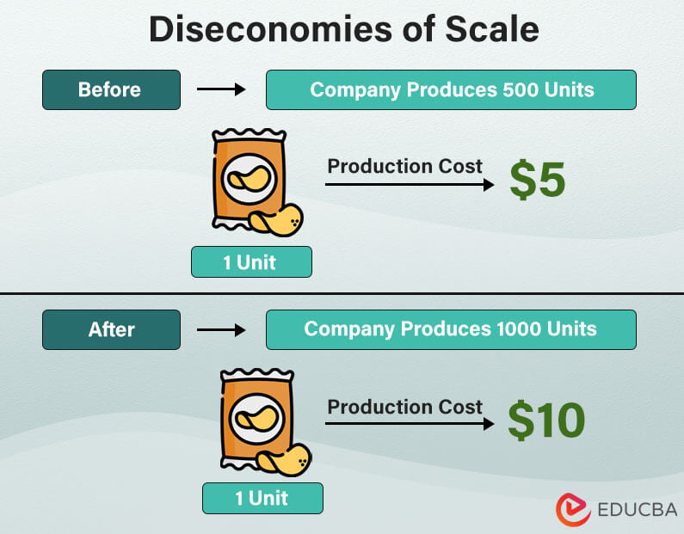
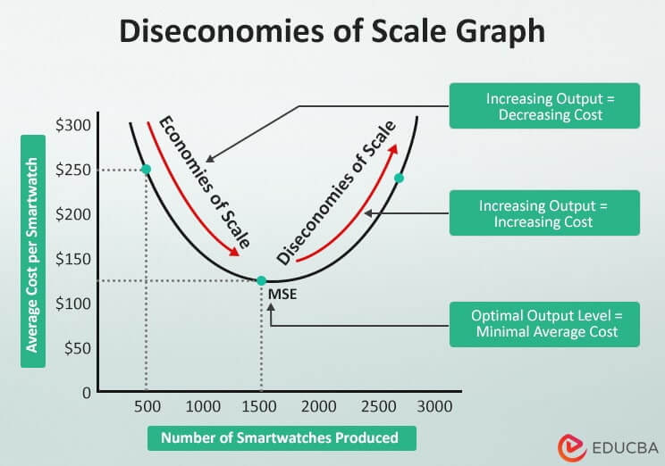
Diseconomies of Scale

Slide 22
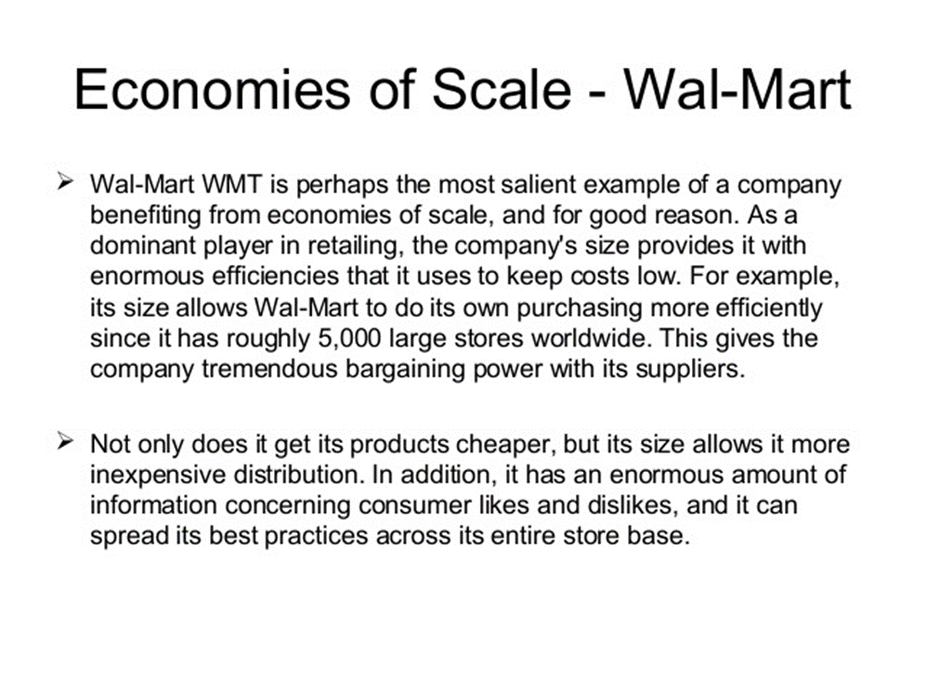

Slide 23
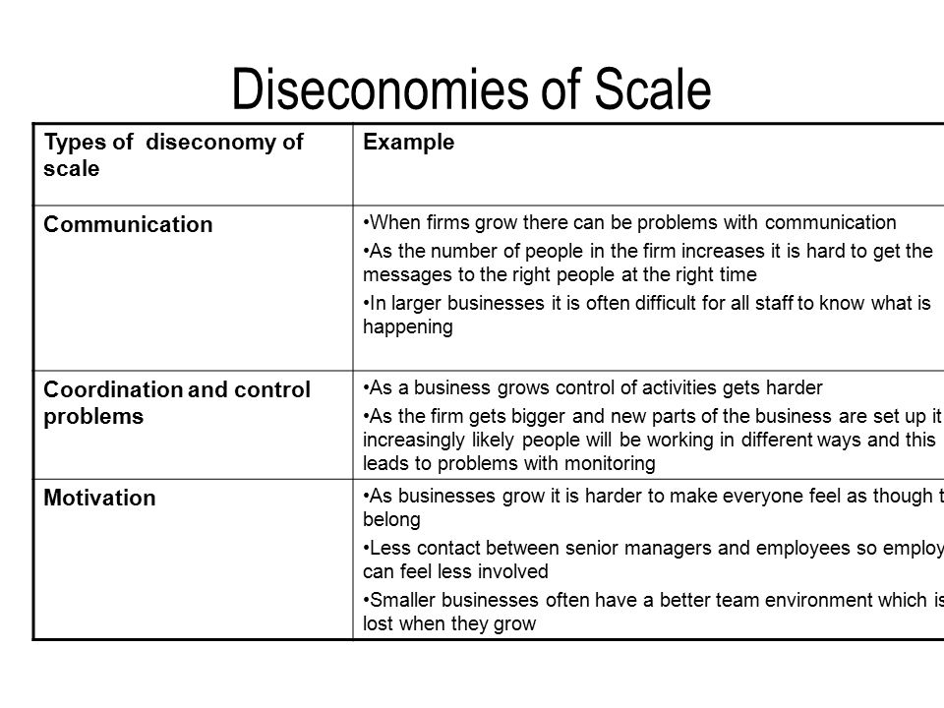

Slide 24
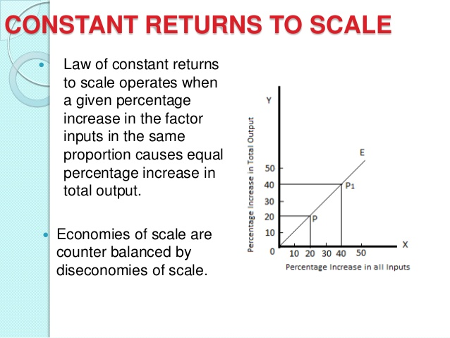

Slide 25
Economies of Scope vs Diseconomies of Scope
Economies of Scope
Diseconomies of Scope
If the total cost of production is lower when two products are produced together than when they are produced separately.
The total cost of production is higher when they are produced together than when made separately.

Slide 26
Economies of Scope
In oil refining the inherent chemical properties of crude oil guarantee economies of scope.
Crude oil is a collection of a number of very different hydrocarbon molecules: refining is the process of separating these molecules into useful products.
It is physically impossible for refining company to produce only gasoline (or kerosene, diesel, petrol, lubricants or whetever petroleum products might be fetching highest price at time).
While refineries have some limited ability to change the mix of products they can pull out of each barrel of crude oil, this comes at a loss of scope of economies.
That’s why refineries always produce a number of petroleum compounds simultaneously.

Slide 27
Diseconomies of Scope
During 1990s and into Early 2000s banks and insurers worldwide rushed to merge.
In 1998 Citibank combined with the insurer, Travelers Group is one of the world’s largest mergers to form Citigroup.
In 2001, the German insurer, Allianz acquired Dresdner Bank.
The French bancassurance model promised higher profits through boosting demand and economies of scope in service provision. The underlying theory was that the same institution could provide clients with wide range of services and products including loans, deposits, investments and insurance.

Slide 28
Diseconomies of Scope
In reality economies of scope were difficult to realise.
Consumers make deposits and use many other banking services on a routine basis.
By contrast investments and insurance are relatively big ticket items which consumers buy infrequently.
So marketing and supporting insurance requires different skills than banking services.
In 2002 just four years after merger, Citigroup spun off Travelers Property and Casualty Insurance to its shareholders. In 2008, Allianz sold Dresdner to Commerzbank for € 5.5 billion.

